Slide 1
EF 3450 Computer Lab Session 1
Basic Statistical Analysis

Slide 2
Before We proceed…
R and RStudio should be pre-installed.
Otherwise please download it after the lab session on your computer from following 2 sites,
https://cran.rstudio.com/bin/windows/base/
https://www.rstudio.com/products/rstudio/download2/
And follow the instruction manual if necessary

Slide 3
Checklist
R and RStudio
On Desktop folder:
Script: tut_1_3450_revised_2.R
Data file: T1_Data.csv
contain required data for this exercise, you may store it in any directory and set working directory later on. For convenient, let’s put the file on your Desktop

Slide 4
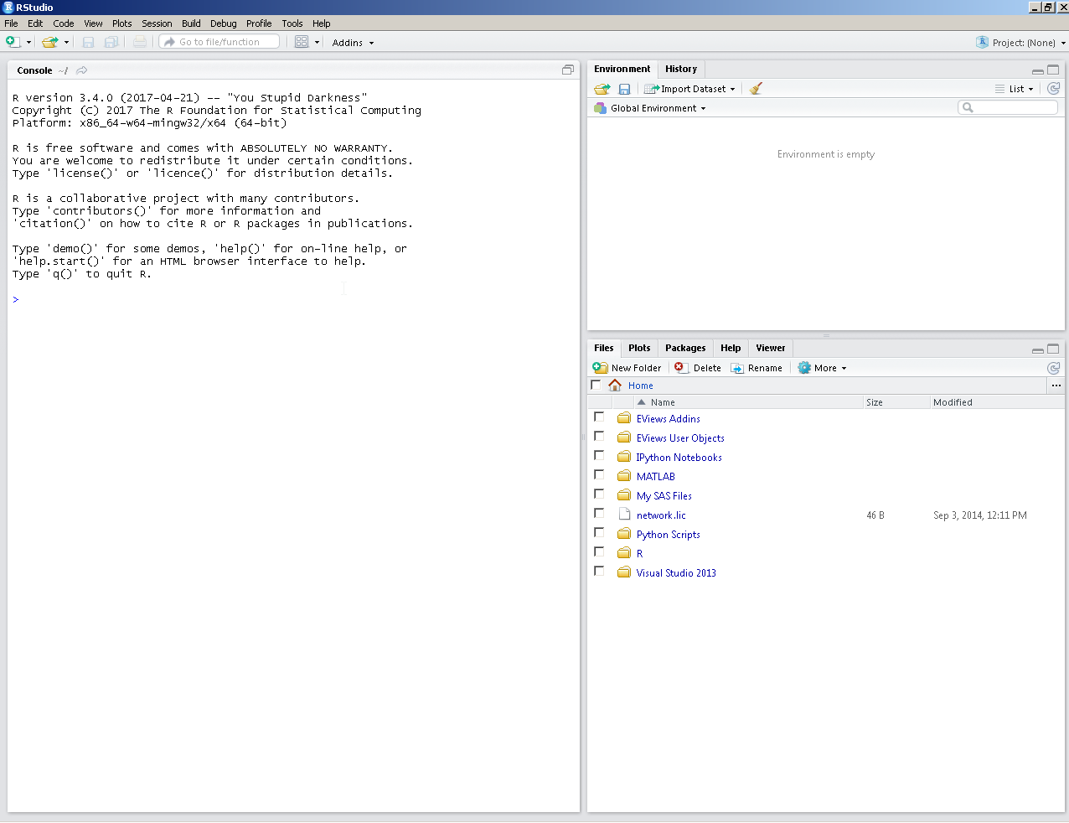
First time running RStudio
Workspace:
Lists objects including datasets and function you defined
Console:
Type directly into the console, or run lines of code from the script window.
Output appears here when you enter commend directly or run lines of script window (will see the script tab when a script is opened).
The > sign means R is ready to accept commands (otherwise it could be still running last command/ last command is not ‘complete’ expect something to end etc)
Plot/Help:
Output appear if you plot or look for R documentation
(ex: plot(X, Y) or ?help(FUNCTION) )

Slide 5
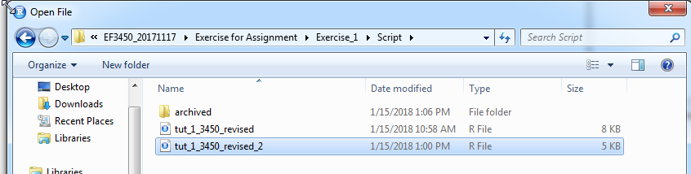
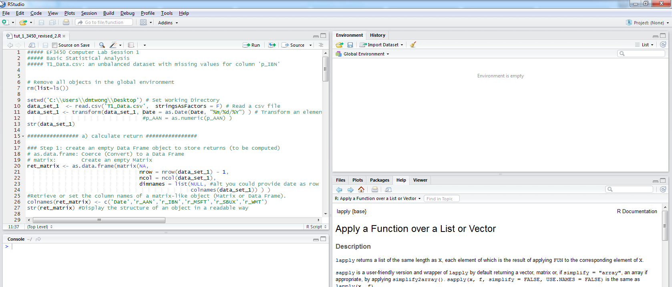
Open an existing script
To open an existing script (with .R as extension) File ➔ Open File
Tut_1_3450_revised_2.R contains things will be covered in this lab.

Slide 6
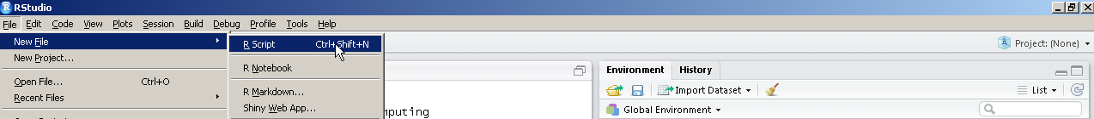
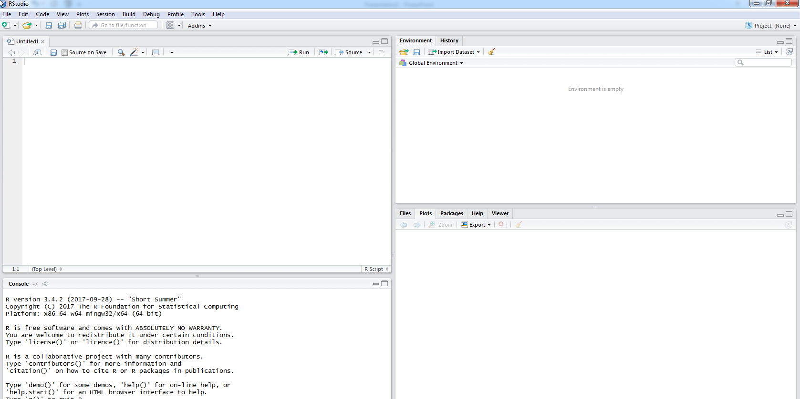
Create a new script
Script:
You could store code in a script and then run line/block/whole script when you are ready. Output will be displayed on Console

Slide 7
Set and Get Working Directory
Type setwd('C:\\Users\\YOURACCOUNT \\Desktop' ) on script tab
Select the line, and then press ‘Ctrl’ + ‘Enter’
console won’t print output for ‘setwd’ function unless it cannot set the directory you provided as working directory (and hence error).
You could type getwd() to verify your current working Directory

Slide 8
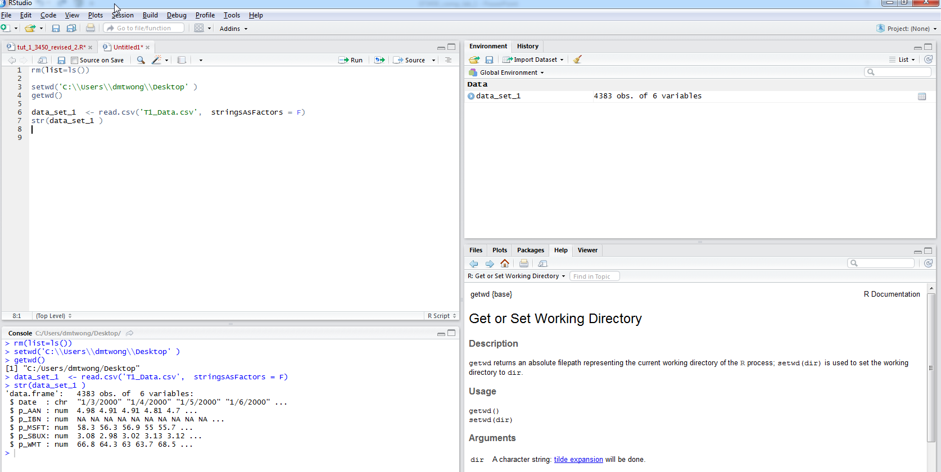
Reading a csv file to work on
Type it on script and run, or directly enter following lines in console
1. data_set_1 <- read.csv('T1_Data.csv', stringsAsFactors = F)
str(data_set_1 )
Type it on script and run, or directly enter following lines in console
You can see data in csv is read and stored as an object called ‘data_set_1’
str(data_set_1) shows it is
A data frame
Each column is a variable and they have different types (character and numeric in this case)
First few value for each column are displayed
Note:
- p_IBN begins with ‘NA’ (you can consider it as missing observations).

Slide 9
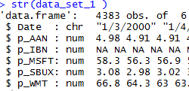
Data Description
"Date" --- currently the values of “Date” is character type and we will change it to “Date” type in the next slide
"p_AAN" --- stock price of Aaron’s Inc
"p_IBN" --- stock price of ICICI Bank
"p_MSFT" --- stock price of Microsoft
"p_SBUX" --- stock price of Starbucks
"p_WMT" --- stock price of Wal-Mart

Slide 10
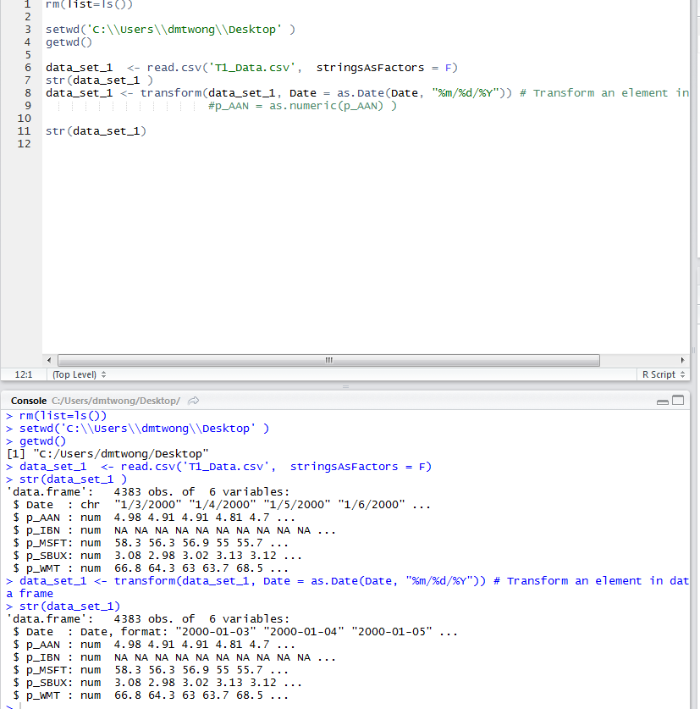
Transform an element in data frame
We could use ‘as.Date’ directly to convert string to dates, but using ‘transform’ allow us to save typing the object ‘data_set_1’ repeatedly. Also in case you want to convert more variables in the same data frame object you could do it in one command.
Everything after ‘#’ are comments (which will not be run)
- MM/DD/YYYY format (similarly if DD/MM/YYYY) then "%d/%m/%Y" (capitalize do matter; for other date/time format read R documentation by typing ‘?strptime’ )

Slide 11
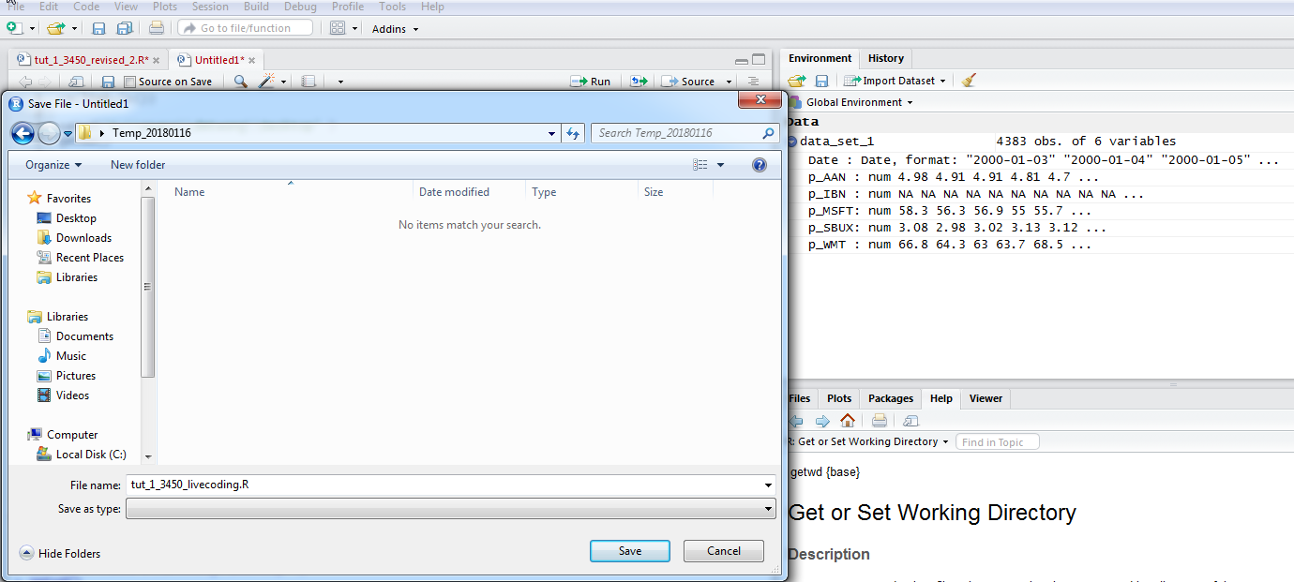
Saving .R Script File
Before further proceed, let’s save script by clicking “File” → “Save As”

Slide 12
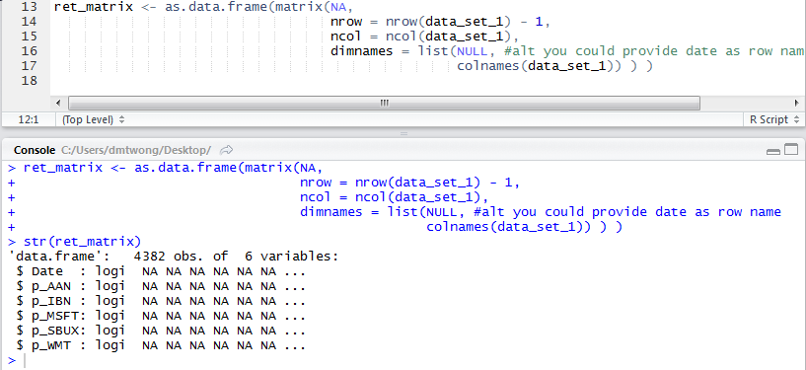
Calculate Returns (ata frame) using price data (data frame)
Step 1: create a data frame object to store returns (to be computed)

Slide 13
Calculate Returns (Data Frame) Using Price Data (Data Frame)
Step 1: create a data frame object to store returns (to be computed)

Slide 14
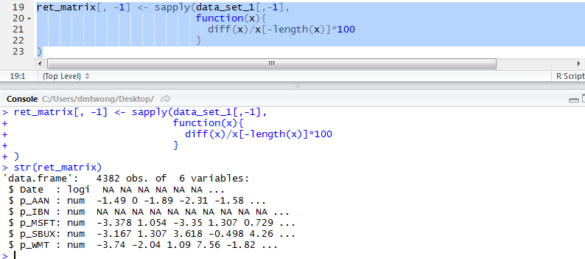
Calculate Returns (cont.)
Step 2: compute returns for each stock (each column except ‘Date’ in data frame ‘data_set_1’
Note: function ‘sapply’ (& lapply) require
-- a list as 1st input
-- a function (built-in or anonymous) as 2nd
-- starting from 3rd are optional and are provided as input of the function given (except ‘simplify’ and ‘USE.NAMES’).
It simply apply the provided function on each element of the list.
‘data_set_1’ is
-- a data frame
-- which is a list of 6 elements (and each element represents a column and is an atomic vector).
We apply anonymous function (function without names) to each element except for the ‘Date’ column [we exclude the first element in ‘data_set_1’] and store the result in ‘ret_matrix’ (Again, 1st column is excluded and reserved for ‘Date’)

Slide 15
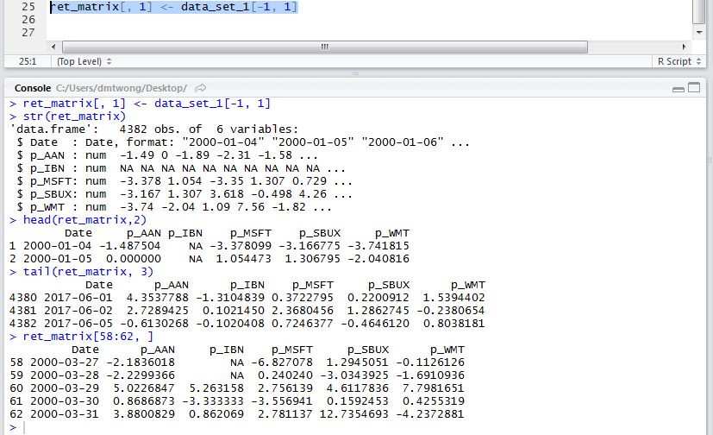
Calculate Returns (cont.)
Step3: assign values of ‘Date’ from ‘data_set_1’

Slide 16
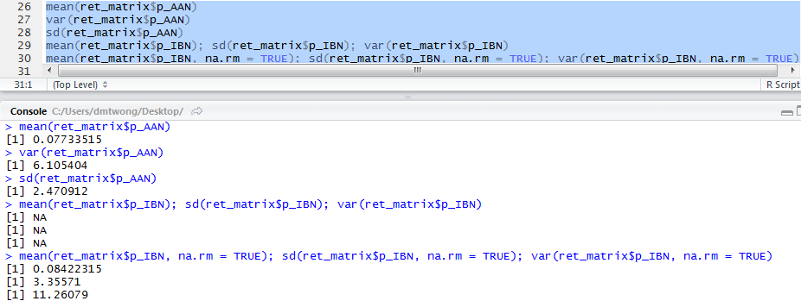
Calculate Summary Statistics
There are built-in function for mean (‘mean’), variance (‘var’), and standard deviation (‘sd’)
If the vector contain no missing values (NA), we can use and provide the vector as 1st argument
Otherwise these built-in function takes additional argument as input for removing NA before calculating (Note: Not all has this features)

Slide 17
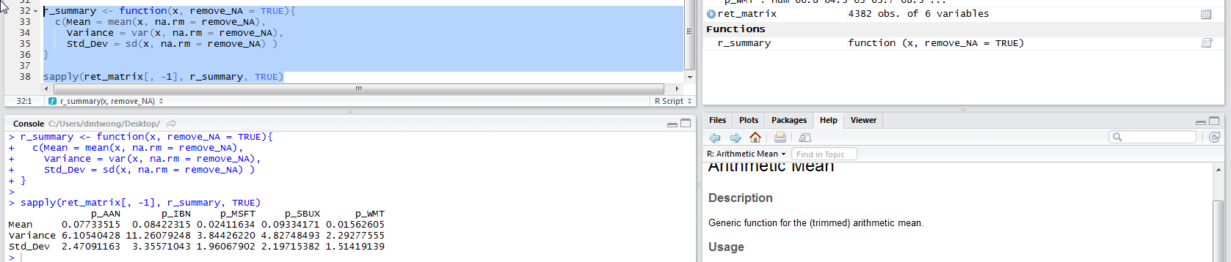
Calculate Summary Statistics (alternative)
We can get the summary statistics 1 by 1 but we can
write a function to report all summary statistics in the same time
And apply it to multiple columns of the data frame

Slide 18
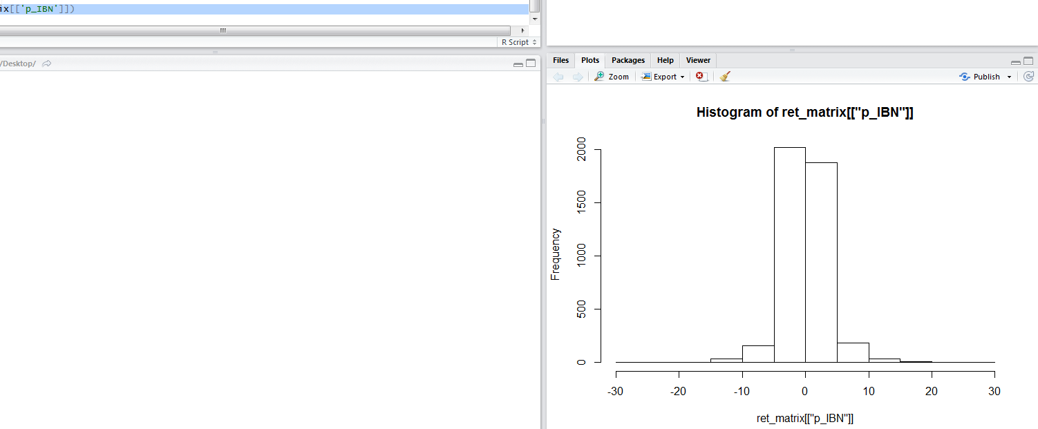
Plot daily returns as a histogram
The simple way is to use ‘hist’ function and provide the series as 1st argument

Slide 19
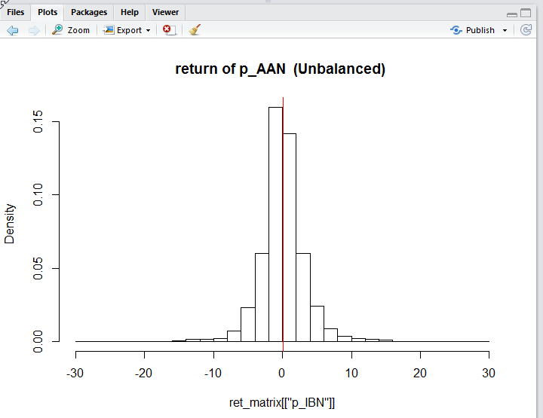
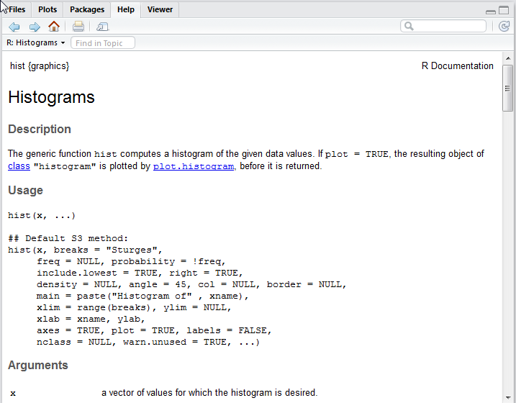
Plot daily returns as a histogram (cont)
You may want something different on your graph; option features can be found on ?hist:

Slide 20
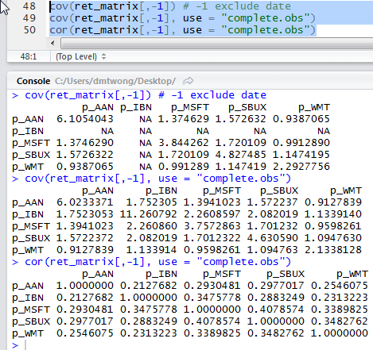
Compute the correlation and covariance
There are built-in function as well ‘cov’, ‘cor’
Just like ‘mean’ if the dataframe contains no missing values (NA), we can use and provide the vector as 1st argument
Otherwise set use = “complete.obs” to remove all observations with NA before calculating

Slide 21
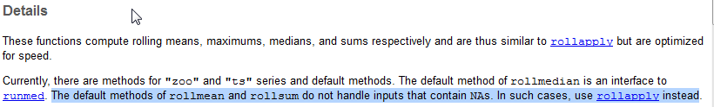
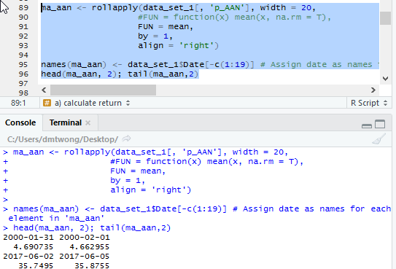
Calculating 20 days Moving Averages
Need a function that can get mean of rolling window
Functions in ‘zoo’ package:
rollmean() if no missing values
rollapply() otherwise
Example on the left compute 20 days moving average of p_AAN
rollapply(data_set_1[, 'p_AAN'], width = 20, FUN = mean, by = 1, align = 'right')

Slide 22
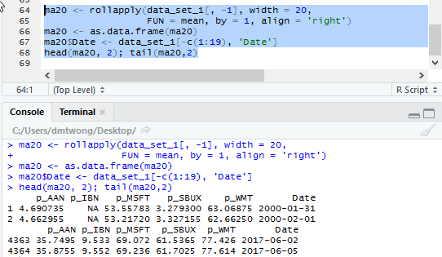
Calculating 20 days Moving Averages (cont’)
Again we can compute moving average for single vector one by one
But We can generalize it to the data frame

Slide 23
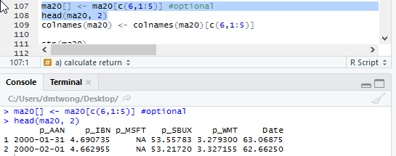
Reorder columns in Data Frame (optional)
Make ‘Date’ as first variable in the data frame using integer index
Note: we change the order of column values but column names remain the same!! We will fix it in next slide

Slide 24
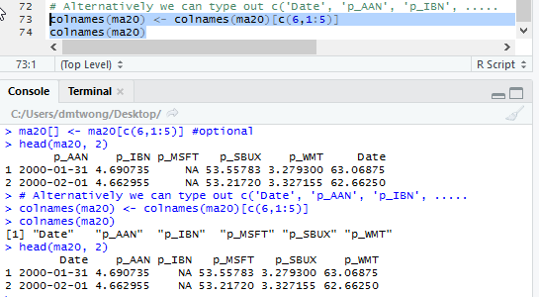
Set and Get Column Names using ‘colnames’

Slide 25
Moving Average starting from 2009
We get the moving average previously
All we need to do is to select (subset) data starting from 2009 using ‘Date’

Slide 26
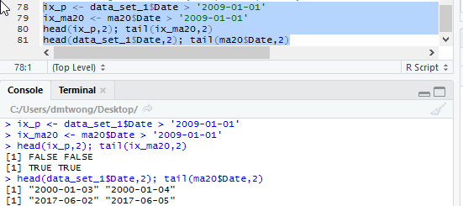
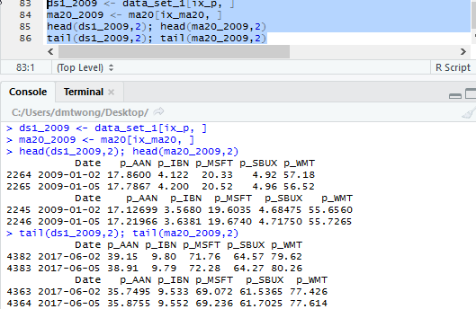
Task 1
Make an index (a logical vector) return true if data is after 2009 and False otherwise
Subset from product of (d) and create two data frame for price and moving average respectively

Slide 27
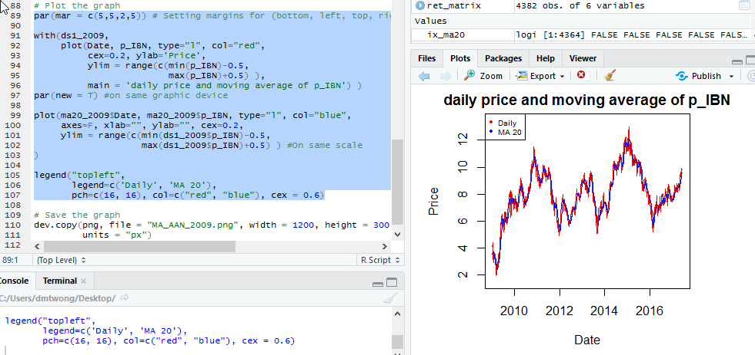
Suppose you would like to plot it out

Slide 28
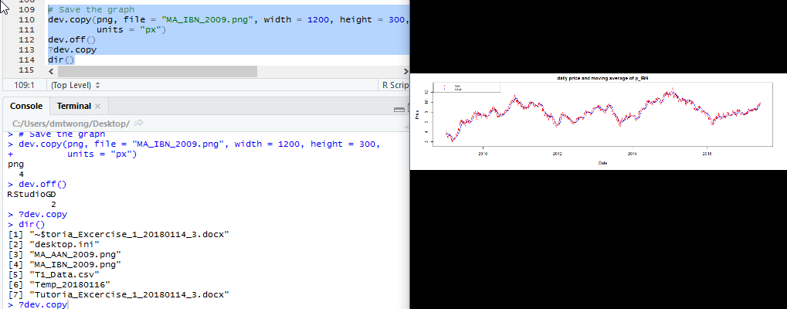
Copy Graphics (from existing window devices) and save the output(optional)

